Slide 1
P.O.W.E.R.
Positive
Outcomes
While
Enjoying
Reading
.
Formerly Known as SSR
Notes:
https://www.youtube.com/watch?v=nm6DO_7px1I
FYI-C and C music factory does not sing this song.

Slide 2
Jigsaw Activity
Divide into 3 groups (count off)
Read your group’s text selection
Jot down the main points from the reading
Choose one teammate to share out to the whole group
Notes:
Share out
Tie discussion to ratings. What do you notice about the teachers’ reading self-evaluations? How does that relate to what we’ve just read?
Key take away: Teachers have to be positive reading role models for students
List ways that teachers can get students excited about reading
Every nonreader or reluctant reader is just one one book away from becoming a reader.

Slide 3
What is the P.O.W.E.R. Half Hour?
P.O.W.E.R. is a regularly scheduled, uninterrupted time for both students and teachers to silently read self-selected reading materials.

Slide 4
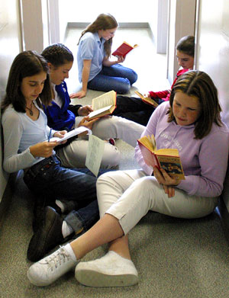
New Initiative: POWER Formally Known as SSR
MWF
30 minutes of intervention time
While small groups of students are pulled for intervention groups, remaining students will engage in P.O.W.E.R.

Slide 5
Why are we Implementing POWER?

Slide 6
Students Spend Little Time Reading
In one study, 90% of the students studied devoted only 1% of their free time to reading and 30% to watching television (Trelease, 2013)
50% of the students read for an average of four minutes or less per day, 30% read two minutes per day, and 10% read nothing at all (Trelease, 2013).
Only 3% of class time is occupied by the act of reading in the middle school, and 2% in the high school (Goodlad, 2004)

Slide 7
Increased Time Spent Reading=Increased Success
According to the OECD (2002), in every country, those who read the most read the best regardless of income level.
According to the IEA (1992), regardless of income level, students who are read to and read the most pages daily have the highest reading skills
Notes:
OECD=Org. for Econ Cooperation and Development
IEA=Int. Education Assoc.

Slide 8
Notes:
If this pattern continues for 4 years, how much more do the students in the 10th percentile have to read each day to catch up to those in the 90th percentile?

Slide 9
P.O.W.E.R. is Not…
a substitute for other language arts instruction
an extra activity that gets plugged into the schedule when another lesson finishes early or dropped from the schedule when a lesson runs longer than expected or a fire drill interrupts class
Notes:
SSR supplements the regular reading program by encouraging independent reading, but it does not replace guided reading.
SSR time is valuable. It is an important part of the weekly schedule. It is scheduled for the same time each day or week so students recognize that SSR time is a priority and so that they can look forward to this special period.

Slide 10
Making POWER Work
Be enthusiastic and POSITIVE!
Make sure students have access to books
Develop a literature-rich classroom environment
Expose children to a variety of genres
Teach students how to find books in the library
Notes:
2. Create comfortable areas for reading; put a large rug, bean bag chairs, large pillows, child-size rockers, and so forth in the library area. Make sure reading area is well-lit. Display prominently posters about various books. Hang student-created book mobiles around reading area. Let students take turns "advertising" their favorite books. For younger students, purchase stuffed animals related to favorite stories -- Winnie the Pooh, Clifford, Arthur, Paddington Bear, etc. Set up a file system through which students can share their comments on the books they've read with the class. Read excerpts from various books aloud to class; show students the book from which you are reading, and let them know that the book is available in the class library. In general, let students see that you place a priority on reading.
3. Some children think they don't like reading because they haven't liked the selection of literature to which they've been exposed. Present nonfiction titles including biographies, autobiographies, historical works, and scientific works. Present a range of fiction including adventure, fantasy, mystery, science fiction, historical fiction, and general selections. Present poetry and humor. Help students understand that books, like ice cream, come in a myriad of flavors. . . . There's something for everyone!

Slide 11
Making POWER Work Continued…
Enlist parental support
Make sure every student has a book to read before POWER time starts
Allow students a high degree of control over their reading selections
Do not make students report on their reading
Notes:
Ask parents to take their child to the library regularly, to buy books for their child, and to donate books their child has outgrown to the school for others to enjoy. Encourage them to discuss the book their child is reading with the child and to let the child see them reading.
2.
3. You may choose to disallow some series of books because of objectionable content, but try not to limit genre or reading level. Whether the child selects an easy book that he or she can read for pure enjoyment or a hard book that poses a special challenge does not matter. All that matters is that the child learns to enjoy reading.
4. Encourage them to share their favorite books with other students, but don't demand that they share. Remember, SSR time is supposed to be fun! -- not another academic exercise.

Slide 12
Making POWER Work Continued…
If a child begins reading a work during POWER time, only to discover that he or she intensely dislikes the chosen book, let the student choose another book.
Utilize audio books paired with print or electronic copies for struggling readers
Teachers read or confer with students while students are reading

Slide 13
Last Year’s Success
Administered Pre- and Post- Denver Reading Attitude Surveys
Overall, the reading habits and attitudes of the students engaged in six months of SSR, three times per week for 23 minutes improved.
Specifically, it appeared that the SSR initiative had a greater impact on students’ perceptions of their reading abilities and habits, than on students’ beliefs about the value of reading

Slide 14
Resources
Located in the Share Drive
Launch lesson
Implementation checklist
Reading Interest Survey
I-Pick bookmarks
Student book recommendation forms
Notes:
1. Hand out launch lesson-any questions?

Slide 15
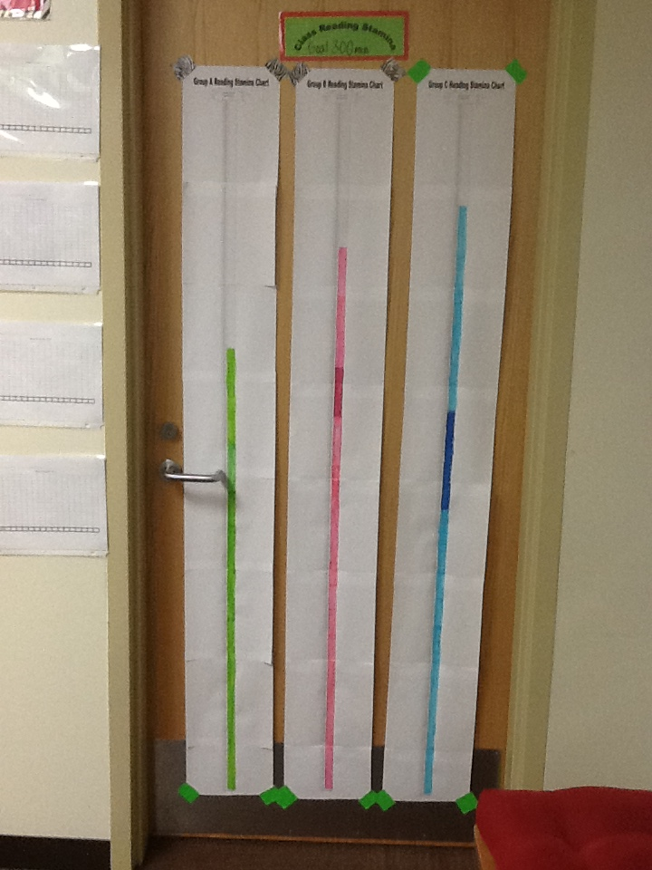
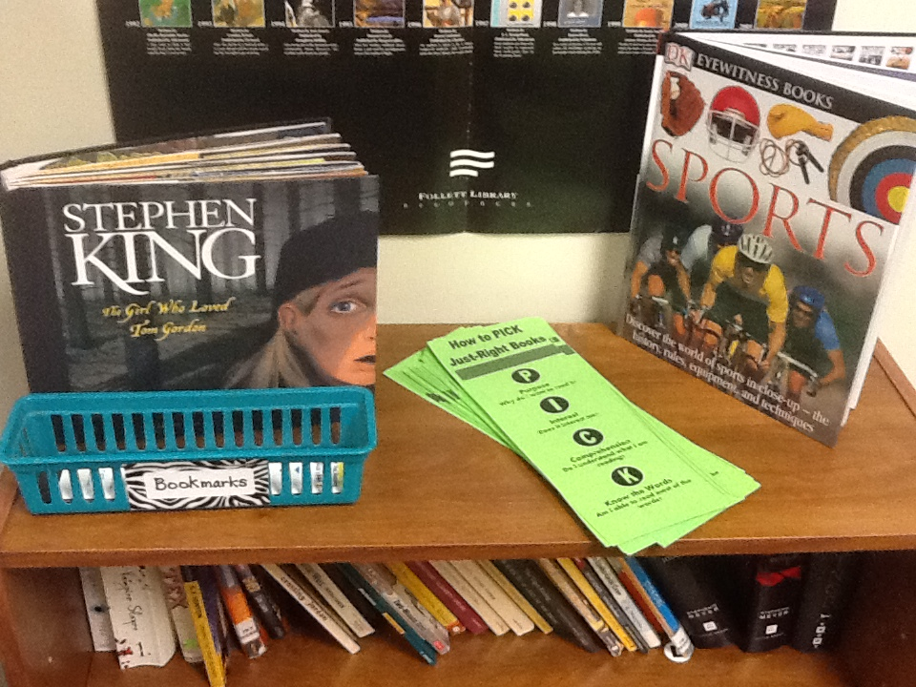
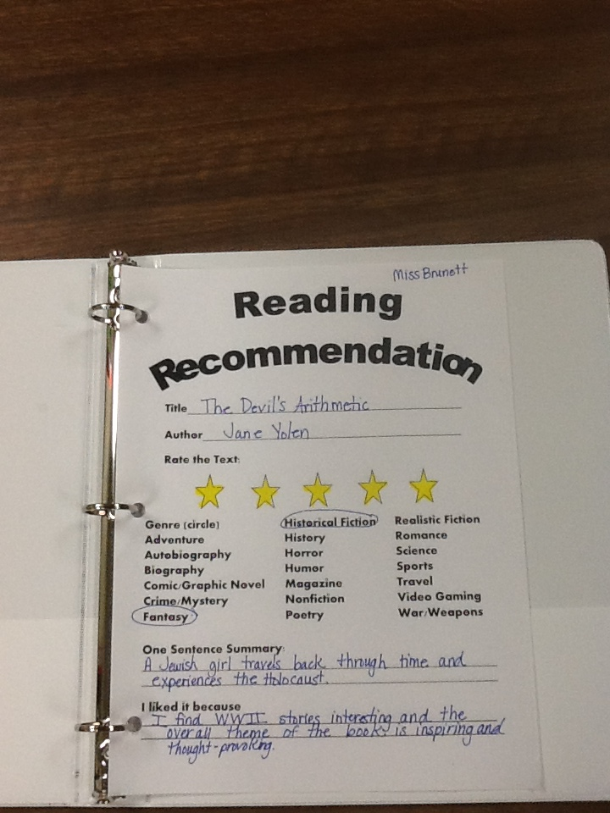

Slide 16
References
Goodlad, J. (2004). A Place Called School
Trelease, J. (2013). The Read Aloud Handbook
Vickery-Smith, J. (2013). “Drop Everything and Read.” Retrieved from http://www.esl4kids.net/tips/read.html

