Slide 1
The “Read Like a What?” Game
Hosted By…

Slide 2
Game Rules and Procedures
Get into equal teams
Sit in rows
A question will be asked
The person at the back of the row initiates the play by either writing down the answer or passing the paper to the person in front of him/her
This process continues until the paper reaches the 1st person in the row
Once the 1st person agrees with the answer, he/she hits the buzzer.
Then rotate seats, move forward one, back goes to front
If the answer is correct, that team scores a point
For every correct answer, all teammates will receive a raffle ticket
One ticket will be drawn for a fabulous prize!!!!

Slide 3
Explain the Read Like a Detective Initiative
Teaches students to…
Read nonfiction texts closely
Make inferences using evidence from texts
Support claims using evidence
Read to learn
Read with a purpose

Slide 4
Why do we focus on nonfiction texts?
Common Core requires us to put more focus on nonfiction texts
We are an information-rich society
Increased practice helps students become better at reading to learn
Notes:
**statistic on % of nonfiction read by adults

Slide 5
What are the three types of questions?
Type 1-Right there (literal)
Type 2-Book and my Brain (inferential)
Type 3-On my own (extension)

Slide 7
Which type of question should we be asking most often and why?
Type 2-Book and my Brain (inferential)
Because students struggle with making inferences
Important life skill

Slide 8
What are the 3 steps in the Read Like a Detective process?
1. Read a question
2. Read to search for clues/evidence
3. Think to formulate an answer

Slide 9
Why do we ask students questions first?

Slide 10
Why do we ask students questions first?
It sets a purpose for the reading
Helps the reader to read strategically
Notes:
Pass out tickets

Slide 11
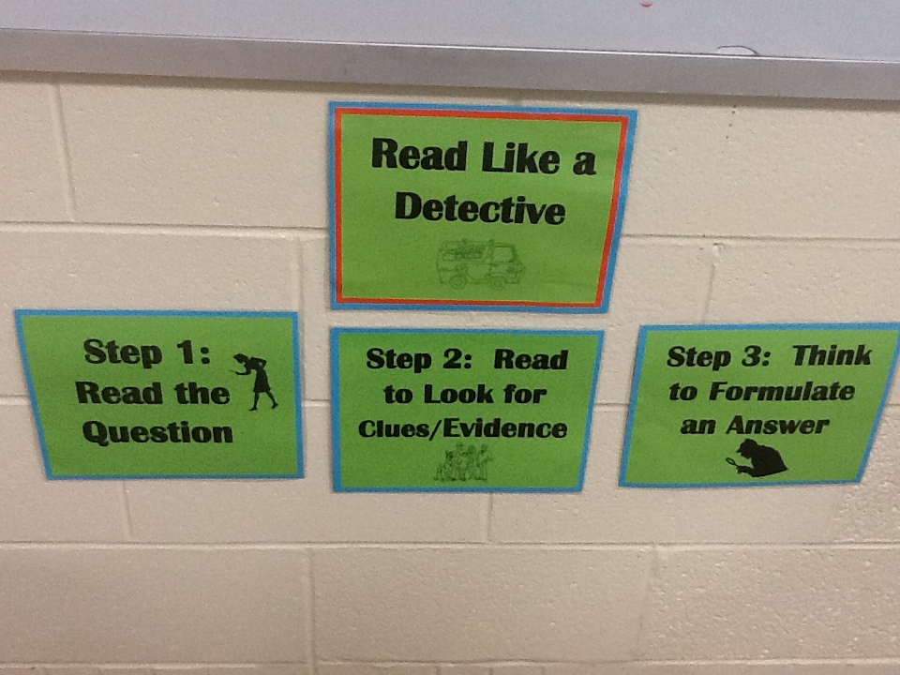
Read Like a Detective Initiative Expectations
3 short articles per month for each class
First Monday of the month submit the informational article form to your building administrator
Posters to hang in rooms
“Read Like a Detective” shirts
Notes:
Hand out form-any questions?

Slide 12
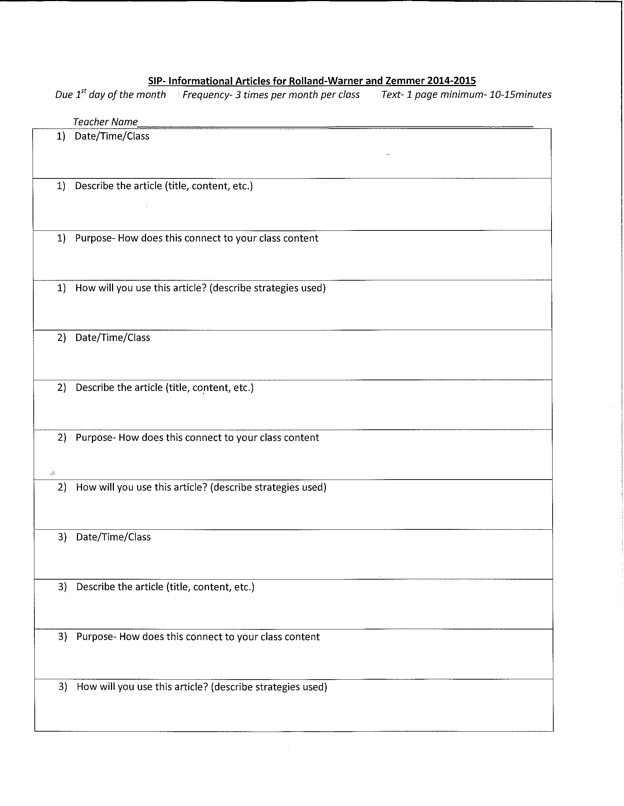

Slide 13
R.L.A.D. Resources
Sample launch lesson plan
Video
Sources for informational texts document
Binders filled with articles
Instructional coaches’ libraries
Notes:
Handout lesson
https://www.youtube.com/watch?v=ScWorlsCRl0&feature=youtu.be

